Slide 1

A Project Management Case Study
Alonso International School Network Infrastructure
Presented by: Team 1
Date:12.06.2024

Slide 2

Initiation

Slide 3

1.1 Project Charter

Slide 4
Project Overview
Project Title: Alonso International School Network Infrastructure
Location: New Giza, 20 minutes from Zayed City and less than 30 from Midtown-Cairo
Project Start Date: March 2024
Project End Date: June 2024
Budget:
- 3 million EGP
Our Fee:
- 25% of the proposed budget over 3 months

Slide 5
1.1.2. Project Description
The Alonso International School is a new Deutsche educational institution aiming to open its doors in September 2024. The project involves designing, procuring, and installing a robust and secure network infrastructure to support the school's needs for 600 students, ranging from 3 to 18 years old.
Physical Infrastructure:
30 classrooms
2 auditoriums
10 labs (science, computer, robotics)
Gym with swimming pool
Stadium for football
Administration building
IT Infrastructure:
School educational platform
Payment system
Private social media platform (school only)

Slide 6
1.1.3. Project Objectives
Design a scalable and secure network infrastructure.
Purchase the necessary hardware and software components.
Install and configure the network infrastructure by September 2024.
Support diverse needs of educational, administrative, and extracurricular activities.
Train key personnel to manage and maintain the network.

Slide 7
1.1.4. Key Deliverables
Network Design Documentation: Detailed blueprint of the network infrastructure.
Purchasing Plan: List of required hardware and software with vendors and costs.
Installation and Configuration: Fully installed and configured network systems.
Training Program: Workshops and manuals for staff training on network management.

Slide 8
1.1.5. Project Scope
Comprehensive network infrastructure design.
Purchasing hardware and software.
Installation and configuration of network components.
Training for the Employee.
Construction and physical building setup.

Slide 9
1.1.6. Project Timeline
Milestone | Date
Project Kick-off | March 2024
Network Design Completion | March 2024
Purchasing Completion | April 2024
Installation and Configuration | April 2024
Staff Training | June 2024
Project Closure | July 2024

Slide 10
1.2 Technical Feasibility Study
1.2.1. Current Technology and Infrastructure
1.2.1.1 Existing Infrastructure:
Location: New Giza, near Zayed City and Midtown-Cairo.
Facilities: 30 classrooms, 2 auditoriums, 10 labs, gym with swimming pool, stadium, administration building.
1.2.1.2 Requirements:
Capacity: Support for 600 students.
IT Infrastructure: Educational platform, payment system, private social media platform.

Slide 11
1.2 Technical Feasibility Study
1.2.2. Network Design
1.2.2.1 Network Layout:
LAN/WAN: Design a Local Area Network (LAN) and Wide Area Network (WAN) to cover all facilities.
Wi-Fi: Robust wireless network with high coverage and reliability.
Security: Implement firewalls, intrusion detection systems, and secure access controls.
1.2.2.2 Hardware and Software:
Servers: High-performance servers for hosting educational and administrative platforms.
Switches/Routers: Enterprise-grade switches and routers for reliable connectivity.
Access Points: High-capacity wireless access points.

Slide 12
1.2 Technical Feasibility Study
1.2.3. Technical Expertise
1.2.3.1 Team Composition:
Network Engineers: Design and implementation experts.
System Administrators: Manage and maintain the network.
Security Specialists: Ensure the network's security.

Slide 13
1.2 Legal Feasibility
1.2.1. Regulatory Compliance
1.2.1.1 Education Regulations:
Ensure the network infrastructure complies with Egyptian educational standards and regulations.
1.2.1.2 Data Protection:
Laws: Compliance with Egyptian data protection laws and international standards (e.g., GDPR if applicable).
Policies: Develop data protection policies to safeguard student and staff data.

Slide 14
1.2 Legal Feasibility
1.2.2. Licensing:
Ensure all software and technology used are properly licensed.
Avoid any infringement of intellectual property rights.
1.2.3. Security and Privacy
1.2.3.1 Security Protocols:
Implement stringent security protocols to protect network integrity.
Ensure compliance with legal requirements for data security.
1.2.3.2 Privacy Policies:
Develop comprehensive privacy policies for student and staff data

Slide 15
1.3 Stackholder Analysis:
Identify stakeholders: Students, teachers, staff, parents
Analyze interests and influence
Develop stakeholder management strategies.

Slide 16
1.4 Triple Constraints Analysis:
Scope: Define project boundaries
Scope Constrain:Curriculum development and educational content
Time: Develop a project timeline
Cost: Budget management strategies

Slide 17
Implimintation

Slide 18
2.1 Implementation Plan Phases:
Planning: Detailed design and requirements gathering. (2 Weeks)
Purchasing: Acquire hardware and software. (2 Weeks)
Installation: Set up network components. (3 Weeks)
Testing: Ensure functionality and security. (1 Week)
Training: Train staff on network management. (4 Month)
Timeline:
Start Date: March 2024
Completion Date: June 2024

Slide 19
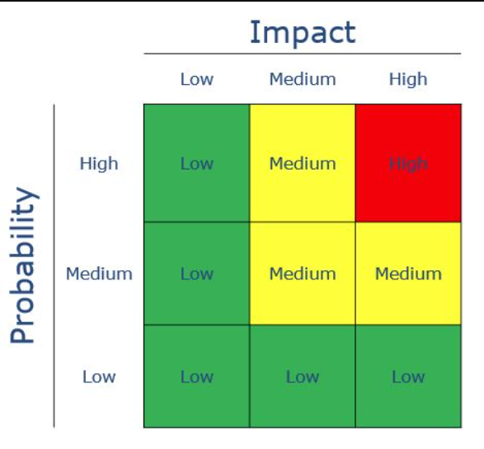
2.2 Risks:
1. High Risk, High Impact:
Example: A critical server failure during peak hours, affecting customer transactions.
Mitigation: Implement redundant servers and real-time monitoring.
2. Medium Risk, Medium Impact:
Example: A delay in software development due to resource constraints.
Mitigation: Allocate additional resources or adjust the project timeline.
3. Low Risk, Low Impact:
Example: Minor changes in project requirements.
Mitigation: Address these changes during regular project updates.

Slide 20
2.1 Implementation Plan Phases:
Communication matrix
Stakeholder | Contact Type | Contact info | frequency
Ministry of Education | In site meeting | Address: No. 12 Al-Falaki Street, off Al-Mubtadian Street | Once or few times maximum
Parents | Send reports Meeting | E-mail:##### Phone:#### Address:#### | Monthly
Teachers | Meetings Make reports | E-mail:**** Phone:***** | Weekly meeting Daily reports
Students |  | Address:$$$$ Parent’s phone:$$$ | Daily

Slide 21

Execution

Slide 22
3.1 Kickoff Meeting:
Agenda: Introductions, project overview, roles, and responsibilities
Participants: Project team, stakeholders
Objectives: Setting goals and expectations
Discussion Points: Project scope, timeline, risks

Slide 23
3.2 Selected Software:
Recommended Software:
Project Management Tool: Microsoft Project, Trello

Slide 24
3.3 Success Criteria
1. Clear communication and documentation
2. Regular progress tracking and reporting
Completion of network design, Purchasing, installation, and training within the specified timeline and budget.
3. Stakeholder engagement and feedback
4. Risk management
5. Quality assurance and testing

Slide 25
Thank You

